Slide 1



National STEM Honor SocietyTM
© National STEM Honor SocietyTM

Slide 2
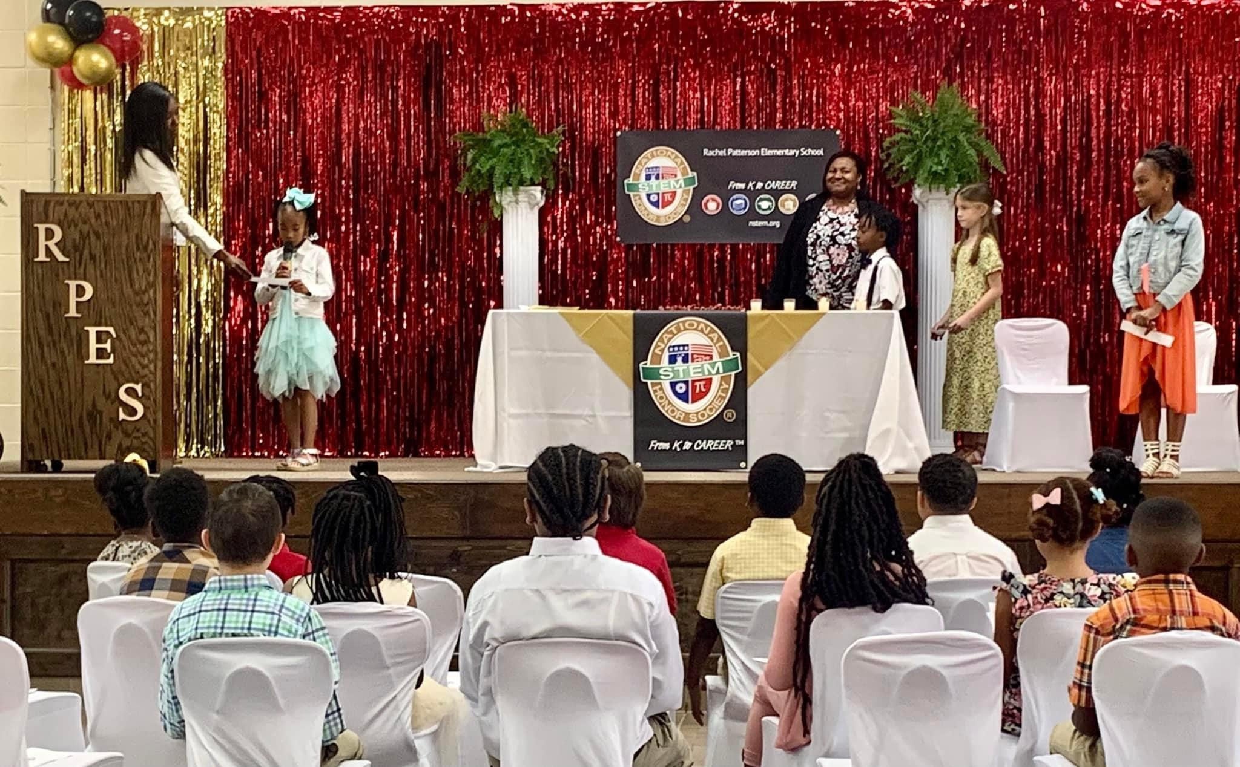
Rachel Patterson Elementary School - Chapter Induction Ceremony
Mission: Inspire innovation and recognize student excellence
From K to CareerTM in the fields of Science, Technology, Engineering, & Mathematics
© National STEM Honor SocietyTM

Slide 3






© National STEM Honor SocietyTM
Notes:
Provides support and resources to students from K to CareerTM
Encourages STEM interest, creativity, and passion!
Available to all, regardless of resources within the community

Slide 4

What is the State of STEM at your school?
© National STEM Honor SocietyTM
Notes:
Align careers with educational experiences
Engage students at an earlier age
Expand the continuum from K to CareerTM
Increase skills in technical areas

Slide 5
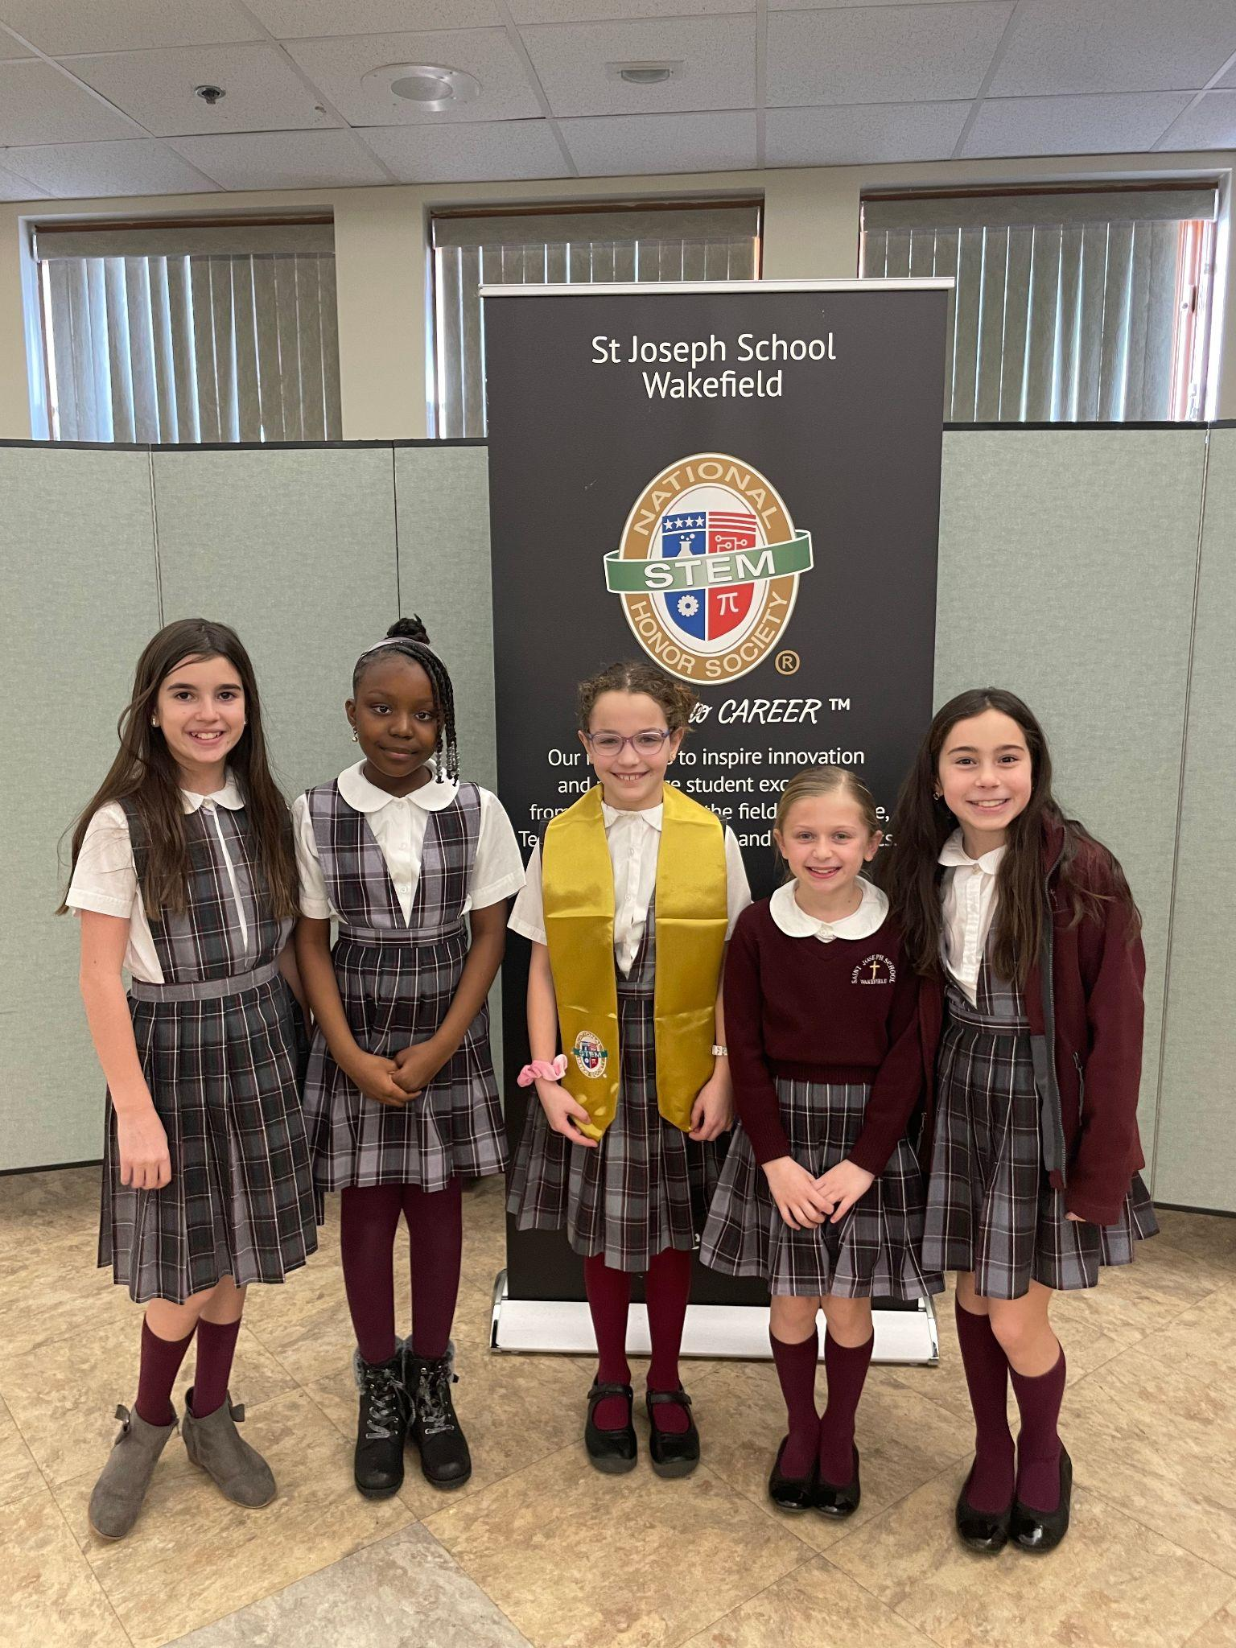
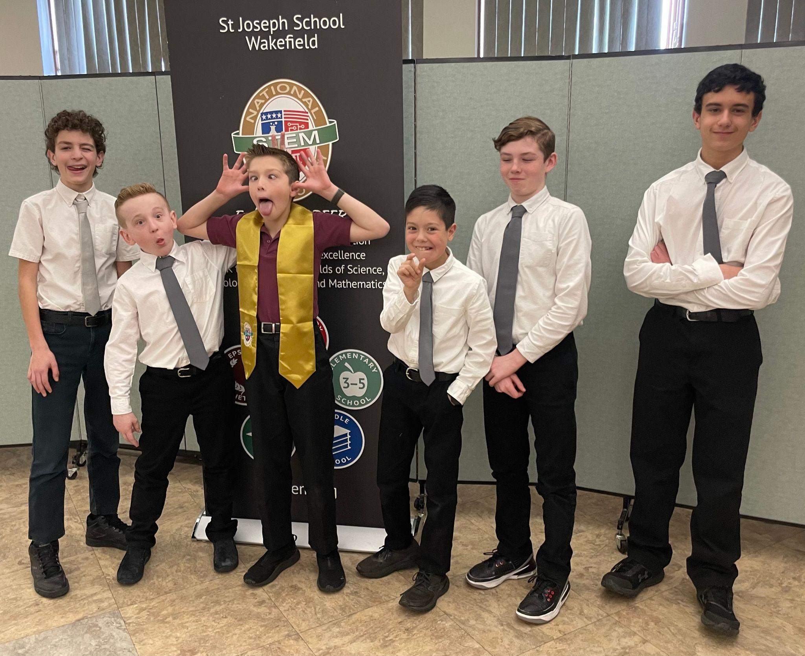
Chapter Based Society
© National STEM Honor SocietyTM

Slide 6

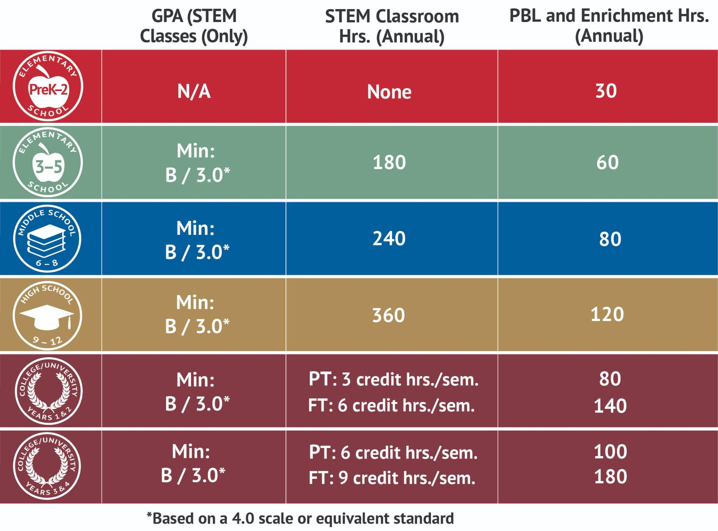
Annual Minimum Eligibility Requirements for Student Membership
© National STEM Honor SocietyTM

Slide 7
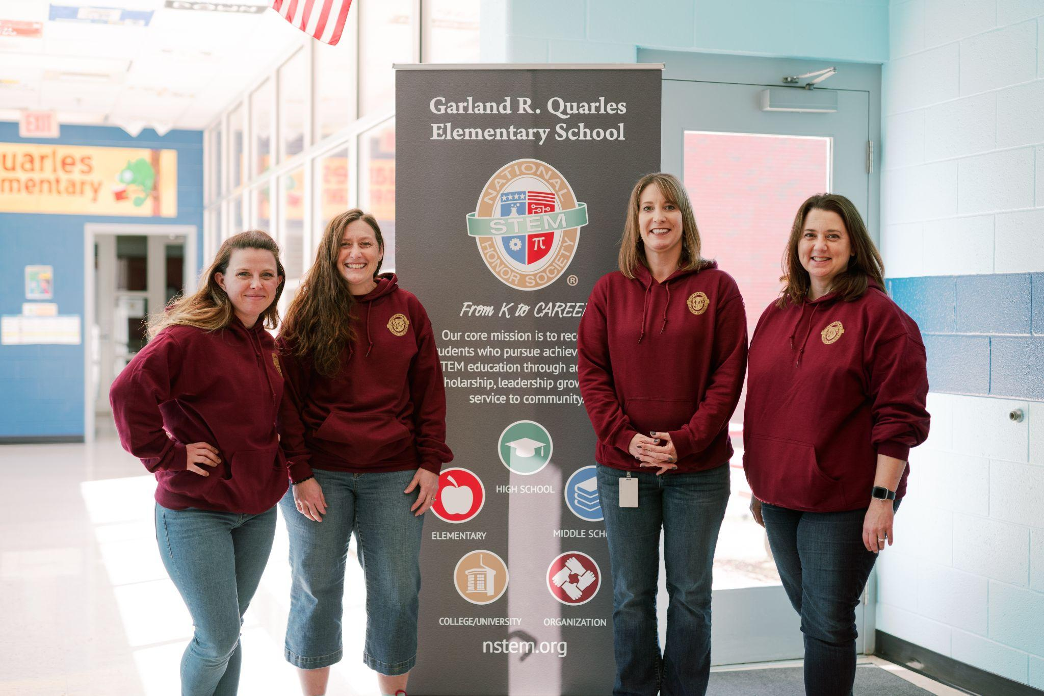
Teachers
are Busy
Garland R. Quarles Elementary School
Chapter Director & Advisors
© National STEM Honor SocietyTM
Notes:
Being an educator is challenging, you’re busy!
We make your job easier by providing tools and resources to build and manage your Chapter
Help you create an engaging student experience!

Slide 8
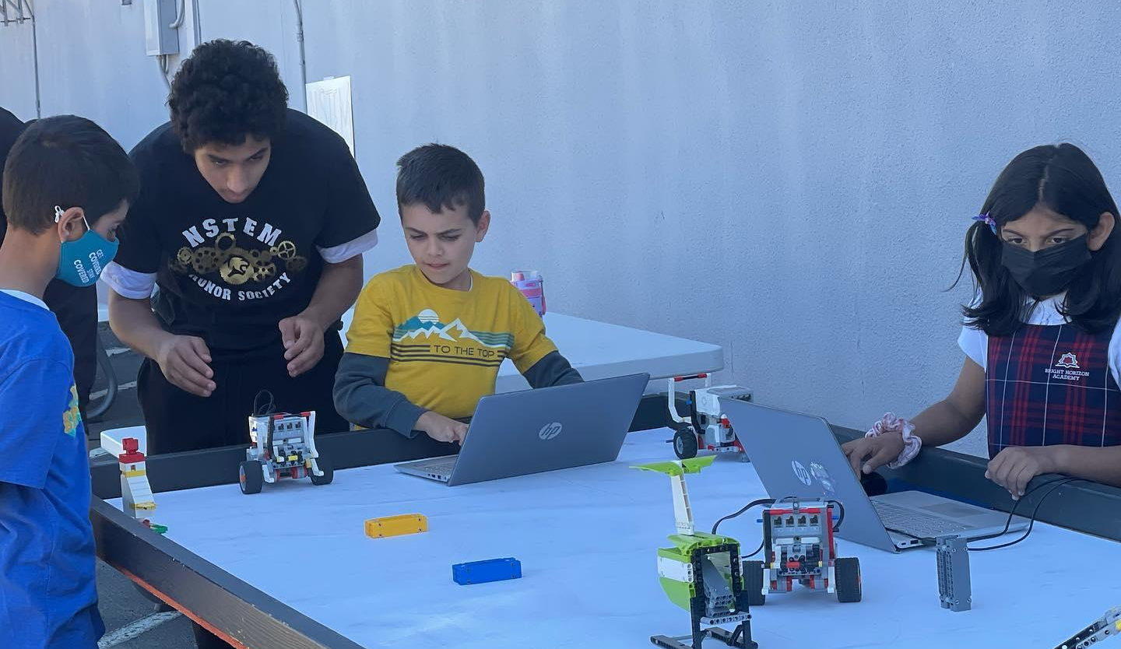
An “Honors” System for all Learners
Bright Horizon Academy/Islamic School of San Diego - Robotics Class
© National STEM Honor SocietyTM
Notes:
NSTEM is designed for ALL STEM learners
GPA requirement is only in STEM courses
Inclusive to all communities that want to participate in STEM education and training

Slide 9
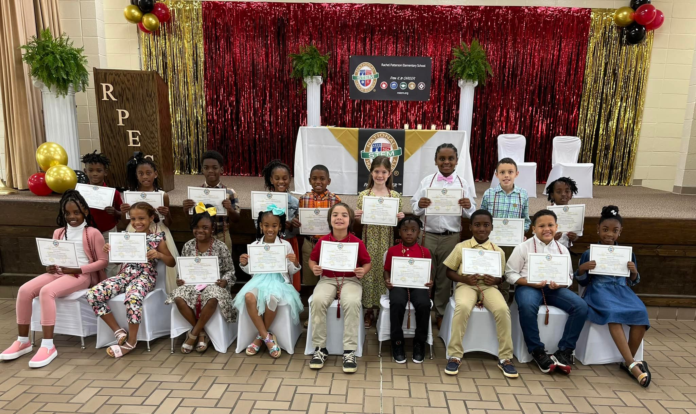
Constitution & Bylaws
Rachel Patterson Elementary - Graduation Ceremony
© National STEM Honor SocietyTM

Slide 10
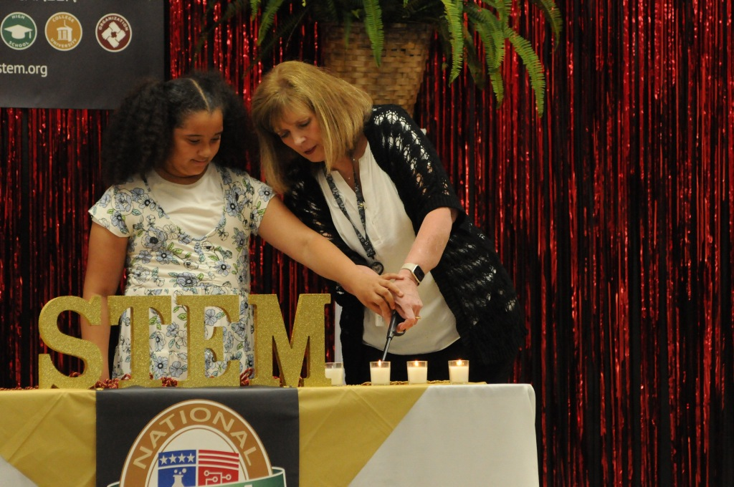








Benefits
© National STEM Honor SocietyTM

Slide 11
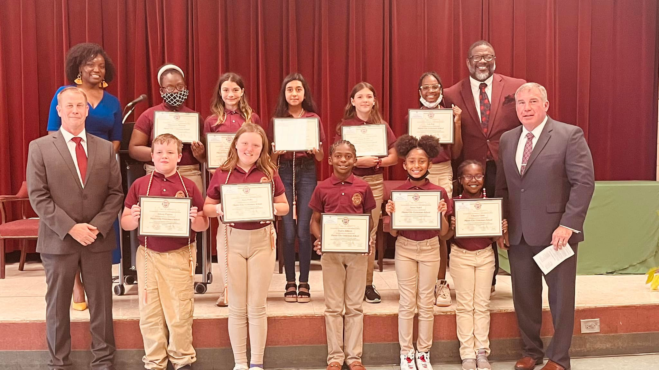
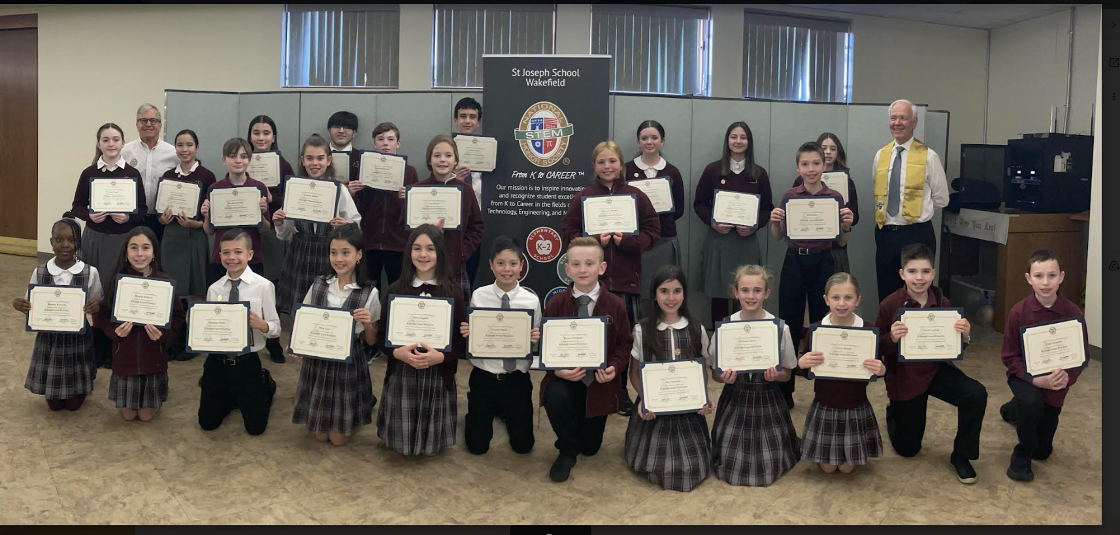
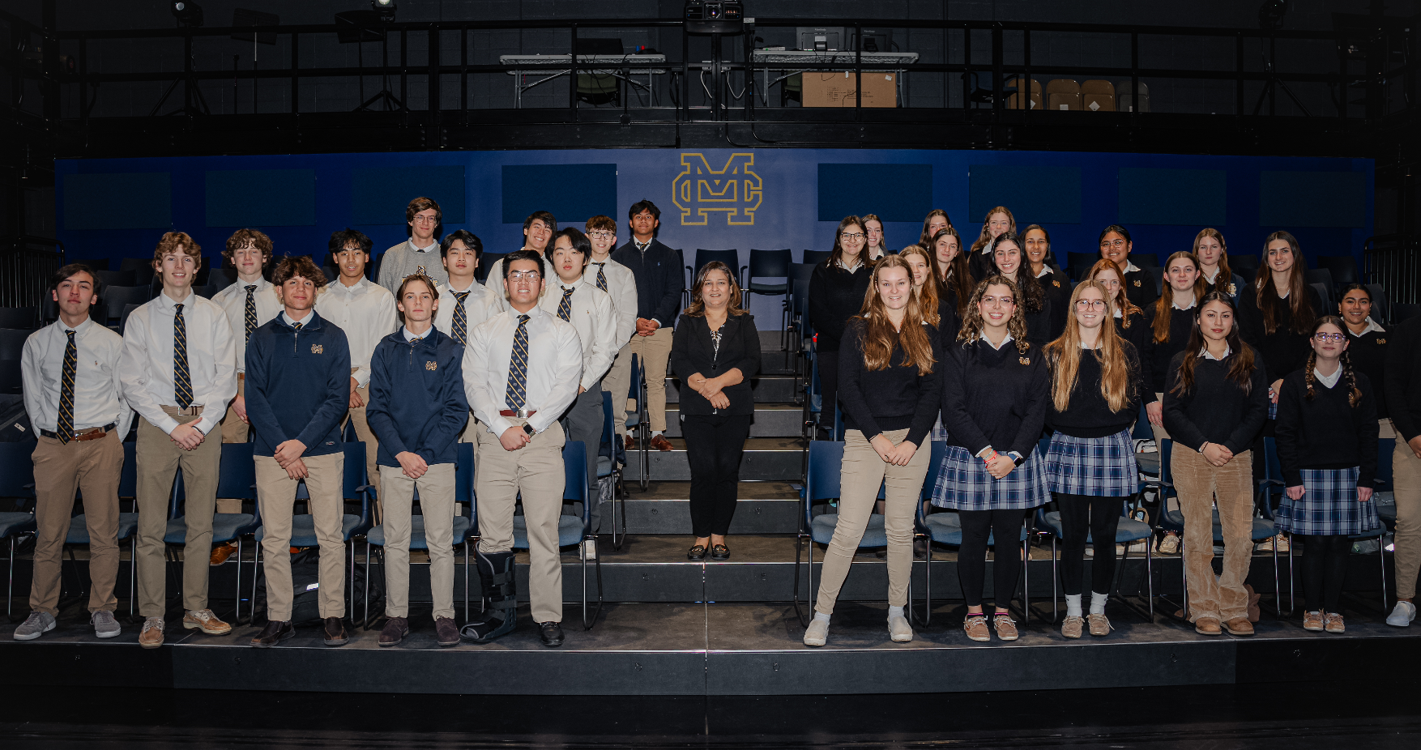
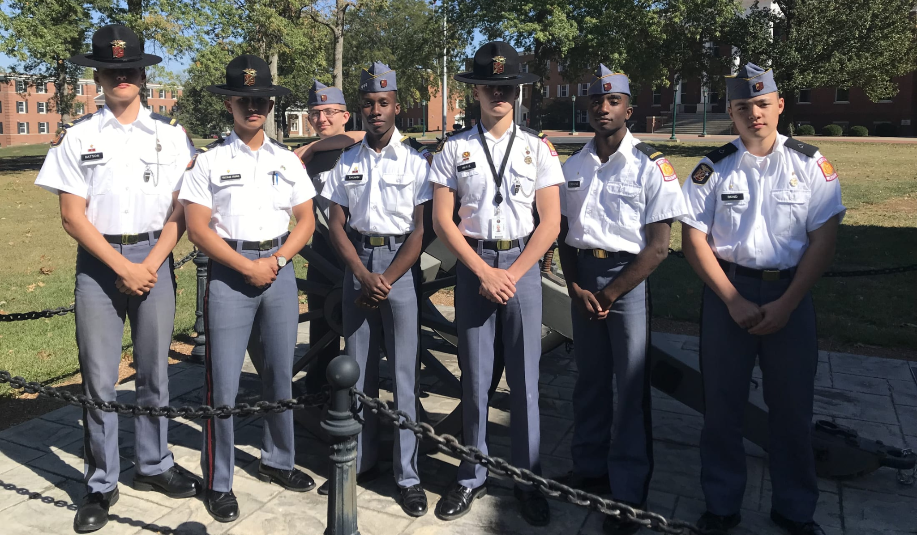
Phenix City Elementary - Induction Ceremony
St. Joseph Middle School - Induction Ceremony
Recognition
Phenix City Elementary - Induction Ceremony
Malden Catholic - Induction Ceremony
Missouri Military Academy - Officers Ceremony

Slide 12

Parents
© National STEM Honor SocietyTM

Slide 13

Project-Based
Learning
© National STEM Honor SocietyTM

Slide 14

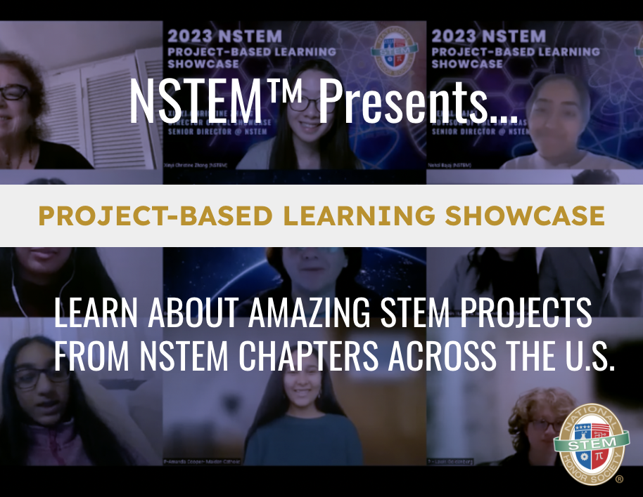
Leadership
© National STEM Honor SocietyTM
© National STEM Honor SocietyTM

Slide 15
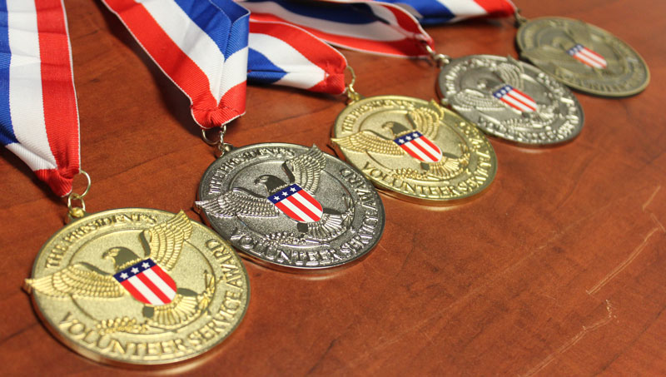

Leadership
Encouraging
Community Service
to solve local, regional,
national, global problems/challenges
© National STEM Honor SocietyTM

Slide 16
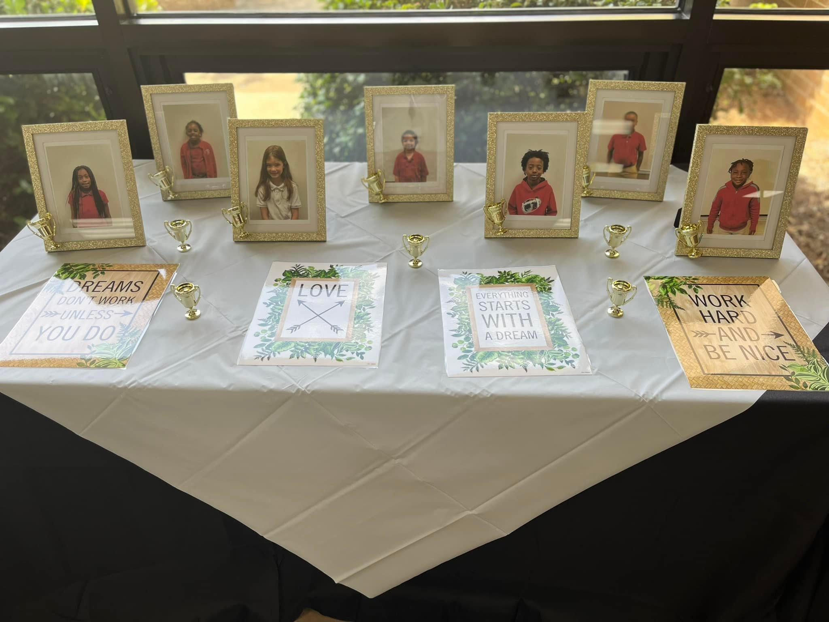
Awards & Scholarships
Rachel Patterson Elementary School - Induction Ceremony
© National STEM Honor SocietyTM
Notes:
NSTEM provides STEM scholarships for exemplary students!
College/University Scholarship
Extracurricular STEM Enrichment Scholarship

Slide 17








Leadership
Leadership
© National STEM Honor SocietyTM

Slide 18

Chapter Officers
© National STEM Honor SocietyTM

Slide 19

Tools
and
Resources
© National STEM Honor SocietyTM

Slide 20




Product & Service Discounts
© National STEM Honor SocietyTM

Slide 21
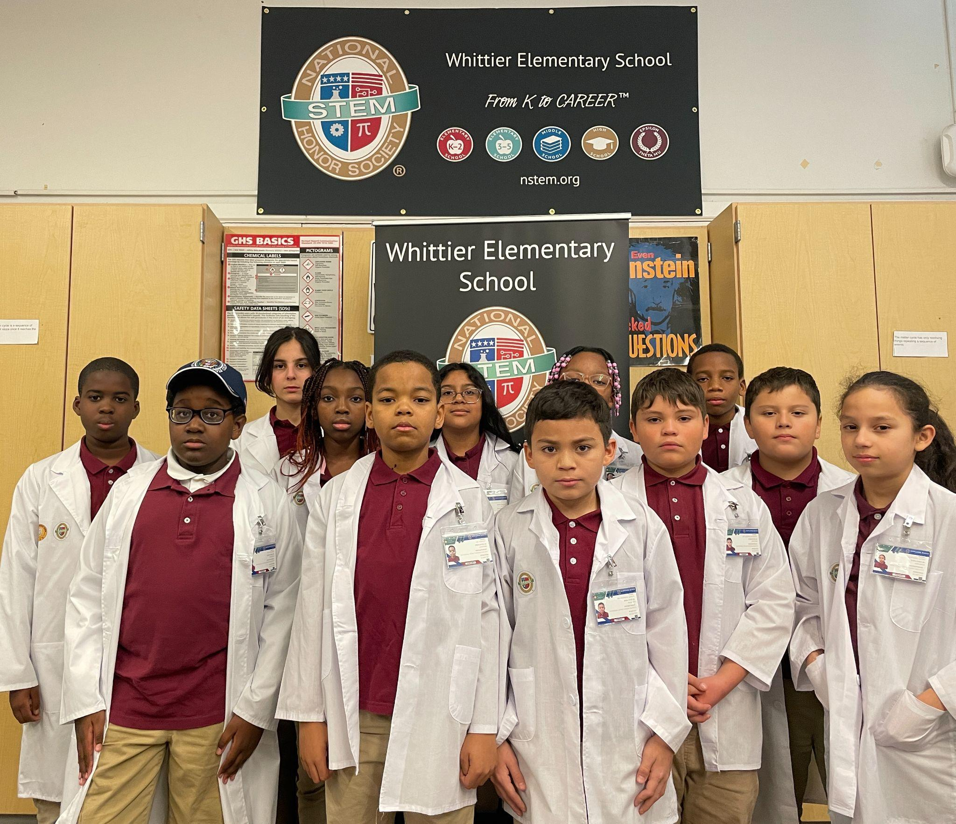
Future
Readiness
Whittier Elementary School -
Science Lab
© National STEM Honor SocietyTM

Slide 22
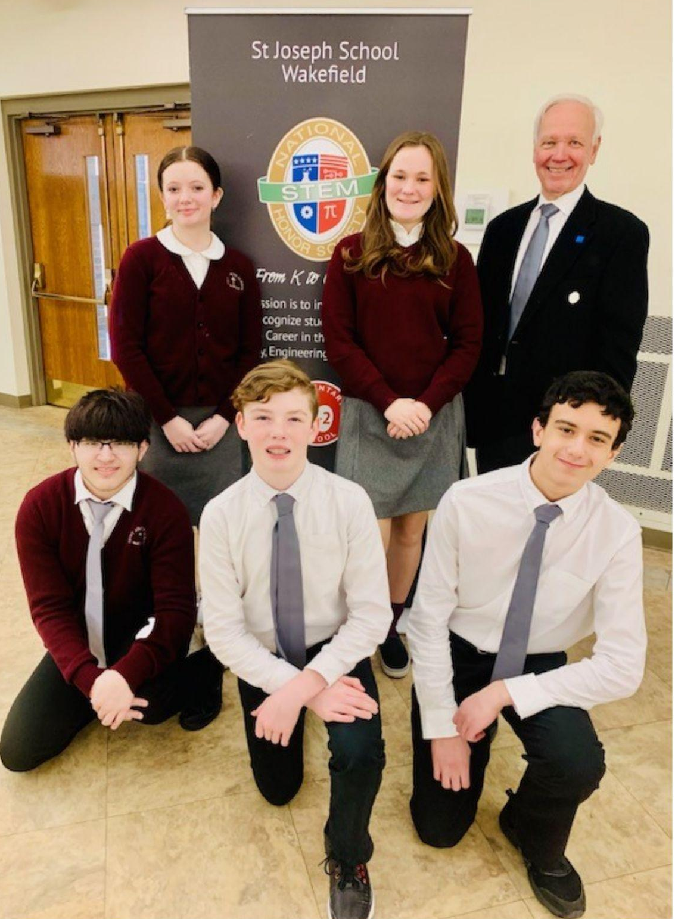
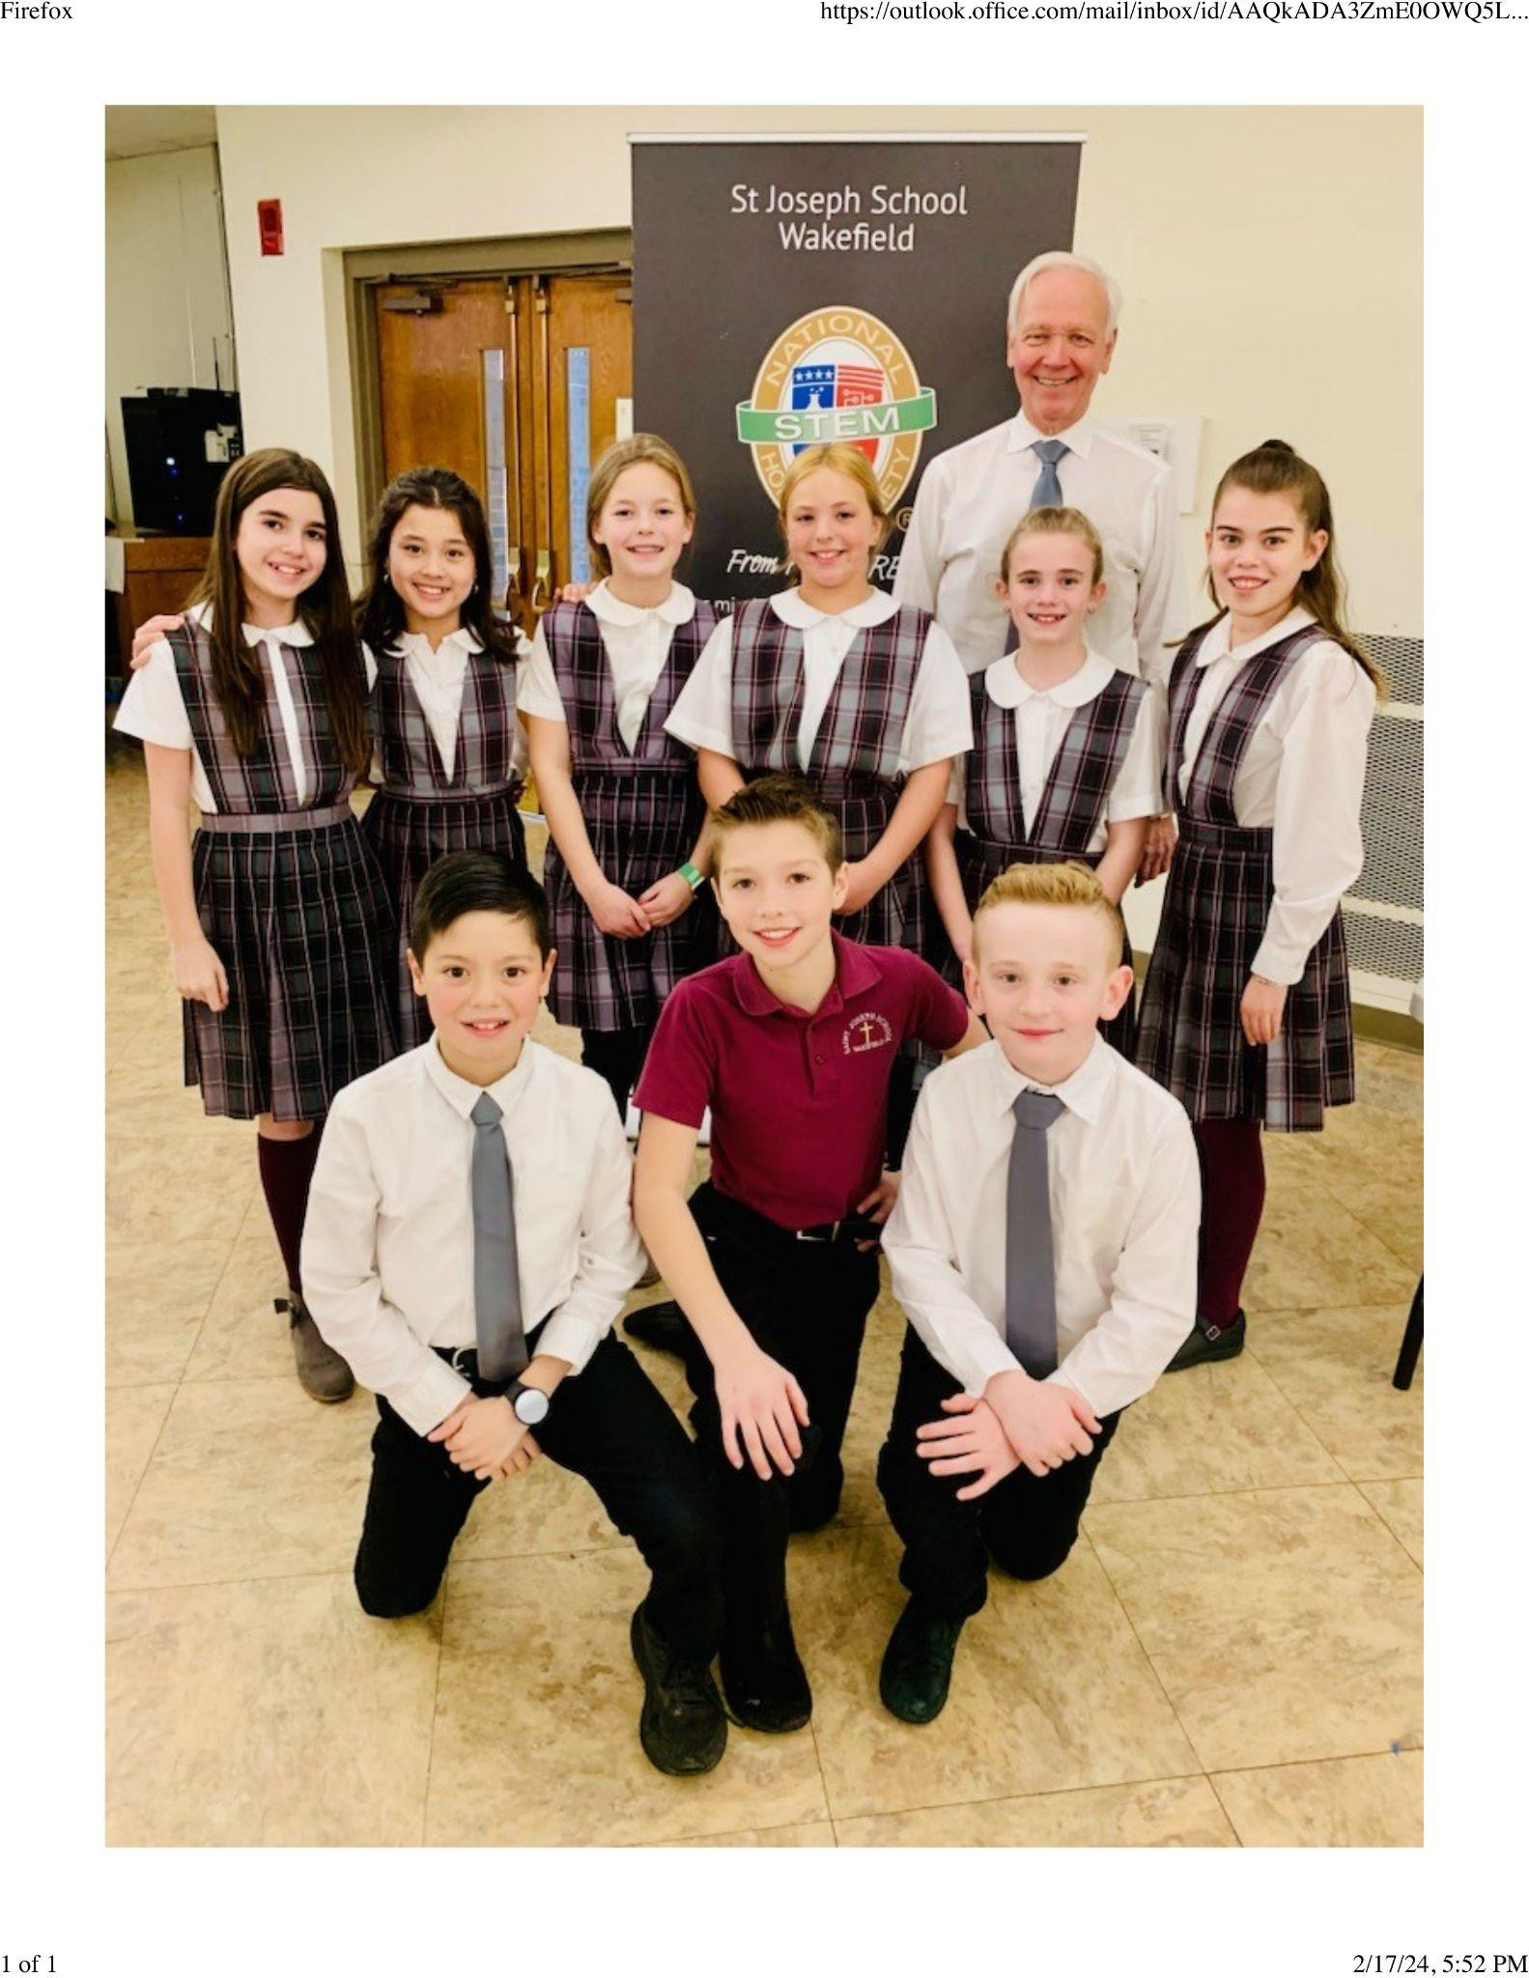
Managing Your Chapter
© National STEM Honor SocietyTM

Slide 23





Commitments
®
© National STEM Honor SocietyTM

Slide 24

Affordability
© National STEM Honor SocietyTM
Notes:
Annual Chapter fee = $295
Maximum student member fee is $20 (optional)
Equitable and accessible for all

Slide 25


Leadership
Chapter Map
© National STEM Honor SocietyTM

Slide 26

Exclusive
Chapter Merchandise
© National STEM Honor SocietyTM
Notes:
Made in Canva
Hoodies, T-shirts, Polos, and MORE!

Slide 27

Apparel & Accessories
© National STEM Honor SocietyTM
Notes:
Made in Canva

Slide 28









Eric Magers
CEO & Founder
Executive
Leadership
Ken Hecht
President
Patricia Kitchens
Chapter Services Director
Advisory
Council
Errika Moore
STEM Funders
Network
Saundra Lamb
Thurgood Marshall Trust
Dr. José Morey
Ad Astra
Dr. Maxine Cain
Chair
STEM Atlanta Women
Kelli List Wells
STEM Leadership Alliance
© National STEM Honor SocietyTM

Slide 29











Partners
Accreditations
& Partners
© National STEM Honor SocietyTM

Slide 30
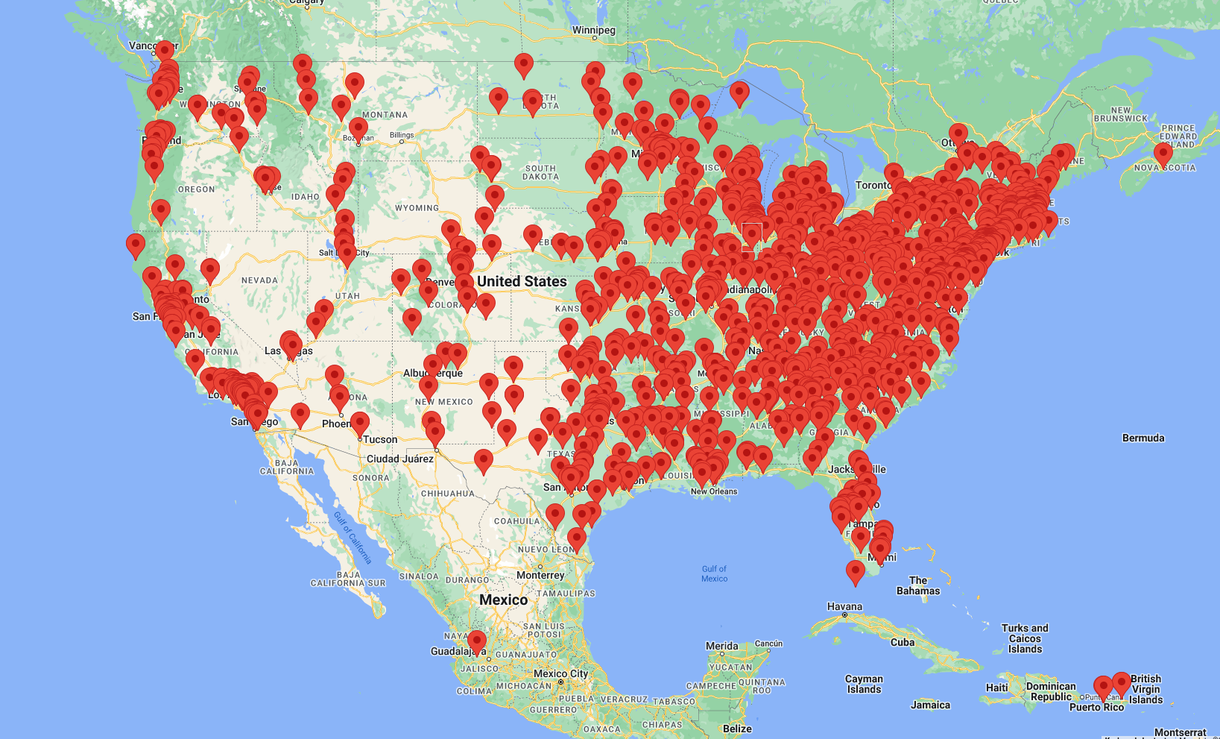
Accredited College
& University Internship
© National STEM Honor SocietyTM
Notes:
We hold accreditation from 1500 colleges and universities nationwide. Our official recognition by admissions boards solidifies our standing as a trusted and reputable institution for prospective students seeking academic excellence and growth

Slide 31
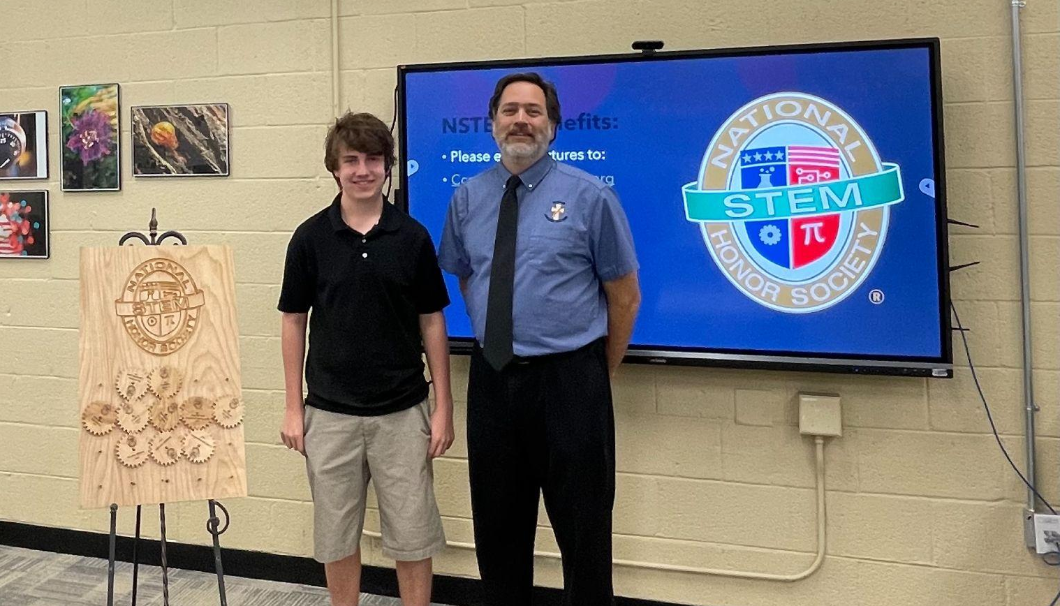
Starting a Chapter
Notre Dame Preparatory High - Award Ceremony
© National STEM Honor SocietyTM

Slide 32








Thank You!
nstem.org
© National STEM Honor SocietyTM

